Slide 1
SOLID Design Principles

Slide 2
What does SOLID design principle mean?
SOLID is a famous term used to describe 5 key design principles that help software developers write better object-oriented code. These principles were introduced by Robert C. Martin back in 2000. Since that time, these principles have become a standard in software design.
SOLID stands for:
S ingle-Responsibility Principle
O pen/Closed Principle
L iskov Substitution Principle
I nterface Segregation Principle
D ependency Inversion Principle

Slide 3
Why use SOLID principles?
Applying the SOLID principles to the codebase offers several important benefits that contribute to long-term software quality and maintainability:
Code is easier to change without breaking things, making ongoing development smoother and less risky.
New features are easier to add, allowing your system to evolve and adapt as requirements change.
Code is easier to test, which leads to more reliable software and simpler quality assurance processes.
Bugs are easier to fix without causing new ones, reducing the likelihood of introducing regressions.
The system is easier to grow over time, supporting scalability and ongoing project success.

Slide 4
Single-responsibility principle
The idea behind single responsibility is simple. Don’t make a class handle more than it should. A class should handle one specific task and have only one reason to change.
For example, in a library system, a book class should deal only with book data. Saving files or printing details should be handled by separate classes.

Slide 5
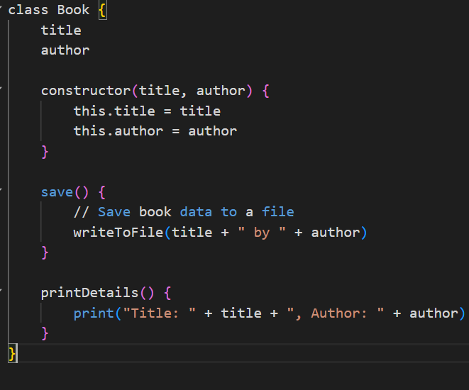
A class that fails SRP
In this example, Book handles data, saving, and printing. That’s too much responsibility for one class.

Slide 6
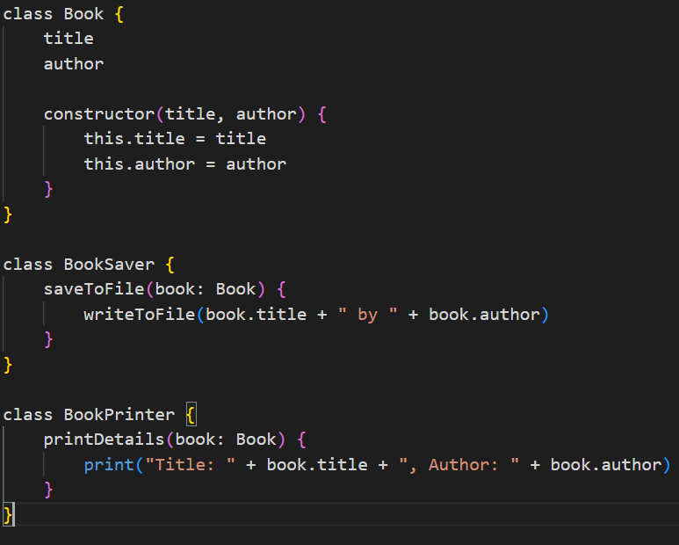
2: Open/closed principle
Applying SRP
Now, each class has a single purpose:
Book holds data
BookSaver handles saving
BookPrinter handles output
Why is this better? Each class does one thing. Changes to saving or printing won’t affect the core Book class, and the code is easier to test and maintain.

Slide 7
2: Open/closed principle
The open/closed principle means that software components like classes and functions should be
Open for extension: You should be able to add new functionality to your code.
Closed for modification: You should not have to change the existing code to add that new functionality.

Slide 8
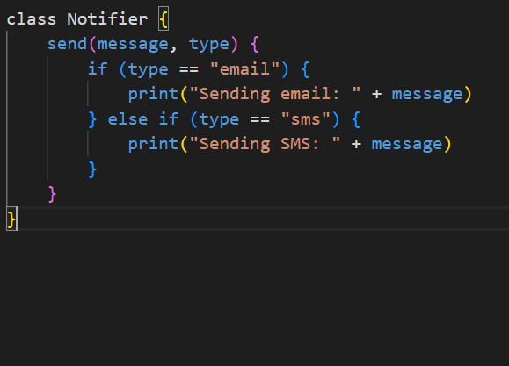
A design that fails OCP
The problem here is that every time you want to support a new type of notification (like push notifications), you must modify Notifier. This violates OCP.

Slide 9
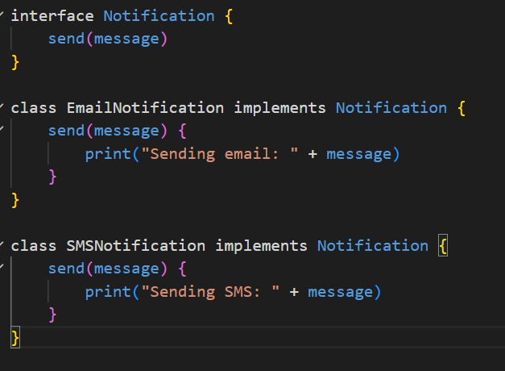
Applying OCP with extension
We can create a base interface and let each notification type handle its own logic.
If we later need push notifications, create a new class.
No change to Notifier is needed. The design is open for extension but closed for modification, as OCP recommends.

Slide 10
3: Liskov substitution principle
The Liskov Substitution Principle suggests a subclass should work anywhere its parent class works, without causing problems. That keeps systems reliable and predictable when extended.

Slide 11
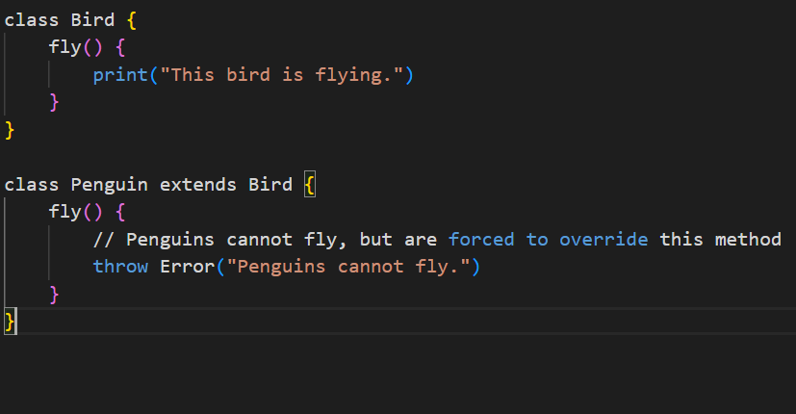
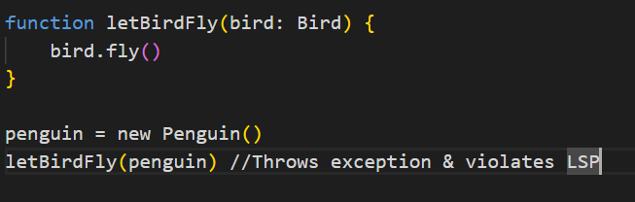
A class that fails LSP
This code doesn’t follow LSP because a Penguin can’t be passed as a Bird to every function that expects a Bird. Look at the example below.
The issue is that not all birds can fly, but our design assumes they can because fly() is part of Bird. Penguins don’t truly fit as a Bird that can fly.

Slide 12
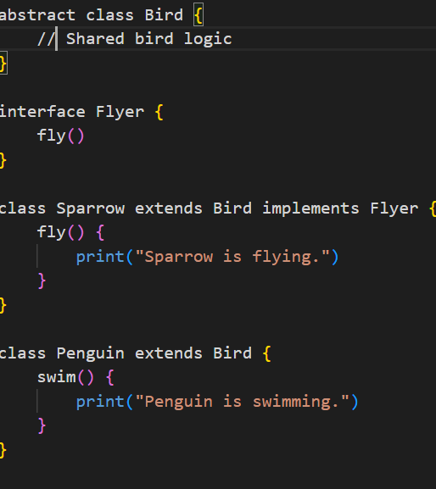
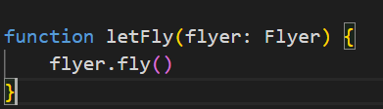
Applying LSP
The solution is to move abilities like fly() out of Bird and into their own interface. That way, only birds that can actually fly implement it.
Now, functions that expect flying birds only work with birds that can actually fly.
This design avoids forcing classes to implement methods that don’t make sense for them.

Slide 13
4: Interface segregation principle
This principle means a class should not be forced to depend on methods it does not need. Instead of creating one large interface that tries to cover everything, it is better to break it down into smaller, focused interfaces.

Slide 14
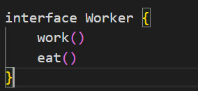
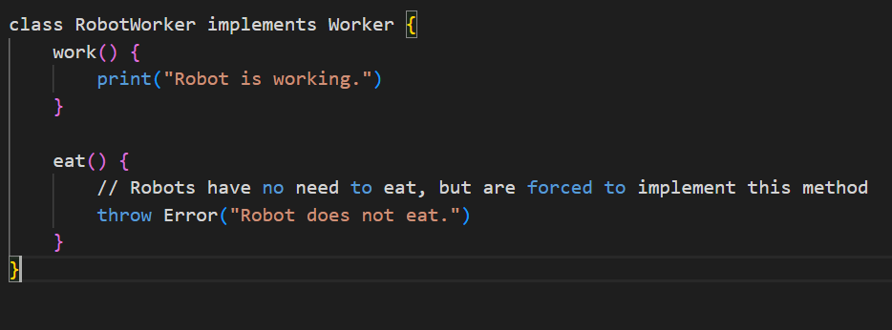
A design that fails ISP
Now imagine a RobotWorker that can work but doesn’t eat.
Here, RobotWorker is forced to depend on a method that makes no sense for it. This violates the Interface Segregation Principle.

Slide 15
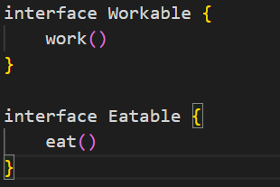
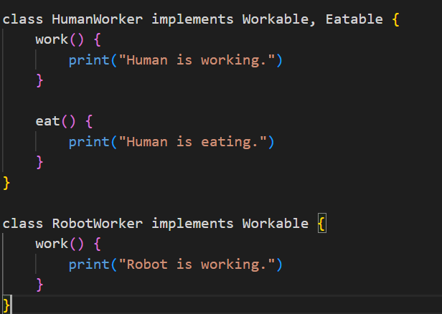
Applying ISP
We can split the interface into smaller, unique pieces.
Now, classes can implement only what they need.
No class is forced to depend on methods it doesn’t need. The design is cleaner and follows the Interface Segregation Principle.

Slide 16
5. Dependency inversion principle
This principle explains that high-level components of the code should not rely on low-level components. Both should rely on abstractions instead. It helps decouple components of a system so they can change independently without causing damage to each other.

Slide 17
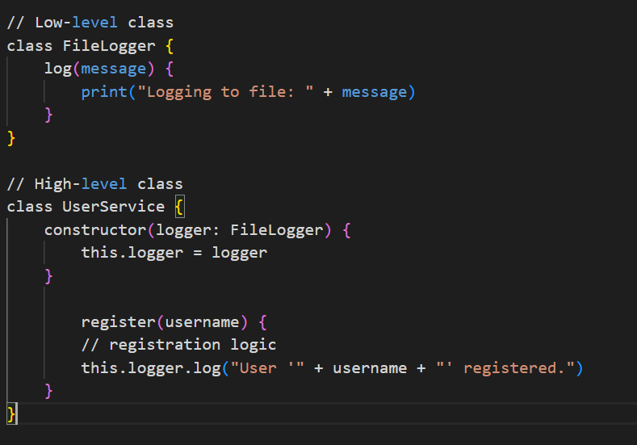
A design that fails DIP
Here, UserService depends directly on FileLogger. If you want to add database logging or switch to another logging method, you will have to modify UserService itself. This tight coupling violates the Dependency Inversion Principle.

Slide 18

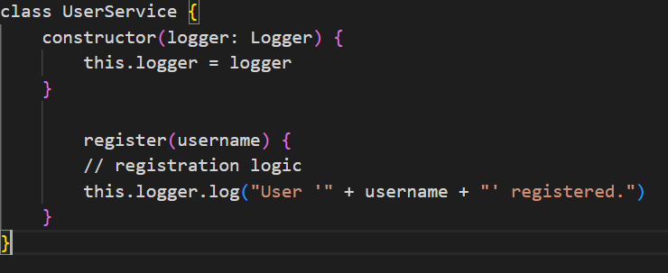
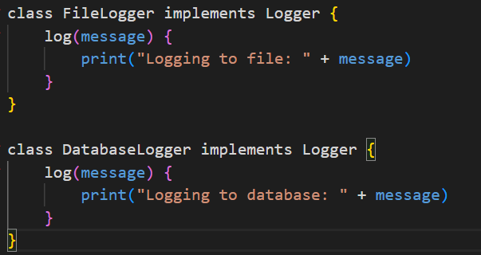
Applying DIP
We can introduce a LoggerInterface abstraction.
Now UserService depends on the abstraction created by the interface.
Then FileLogger, DatabaseLogger, or any other logger can implement this interface.
Now UserService works with any logger without needing changes. Both the high-level service and the low-level logger depend only on the abstraction.

